Slide 1

Assessing Club Health
0

Slide 2


Session Objectives
Identify Characteristics of Healthy Clubs
Analyze Club Health Assessment Reports
Use Resources to Boost Club Health
1

Slide 3
Healthy Clubs
2

Slide 4

aa
What are some characteristics
of healthy clubs?
3

Slide 5
aa
Elements of Club Health
Club members conduct meaningful service activities
Club achieves membership growth and retains new members
Club executes effective internal and external communications
Club events held regularly and are positive and meaningful
Club officers participate in leadership training
Club is in good standing and reports regularly
4

Slide 6
Club Health
Assessment Reports
5

Slide 7
aa
What indicators should I use to determine whether my zone clubs are healthy?
6

Slide 8
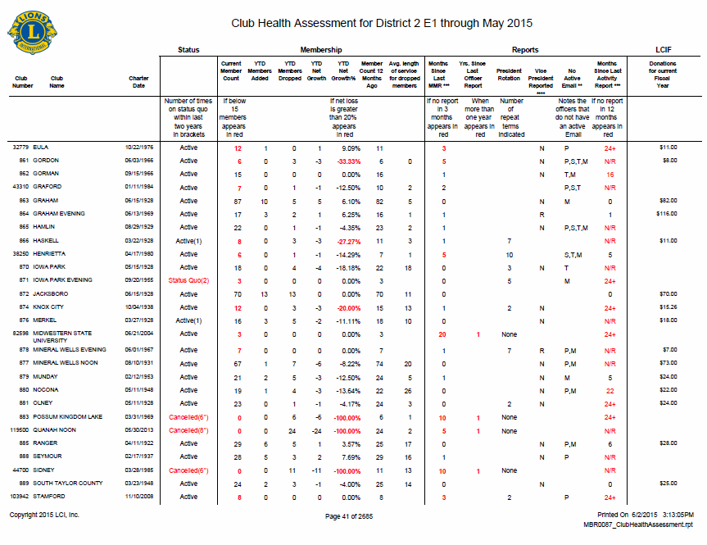
Club Health Assessment
1
Provides a quick look at:
Net Growth Y-T-D
Service Activity Reporting
President Rotation
Membership Reporting History
Club Status
2
3
4
5

Slide 9
aa
Accessing Club Health Assessment Reports
Can be found on the Membership Reports Toolbox web page
Click on the Club/District Heath Assessments link to access the reports
8

Slide 10

Activity
Club Health Assessment
Review each scenario on page 1-2.
Discuss with the participants at your table what you think the status of each club should be.
Be prepared to share your thoughts with the rest of the participants.
Go to 1-2 in your participant manual.
You have 10 minutes to complete the exercise
9

Slide 11
Club Health Resources
10

Slide 12
aa
What resources are available to help boost club health?
11

Slide 13
aa
Available Club Health Resources
Club Health Assessment Action Strategies
Improving Club Quality Webpage
Your Peers
12

Slide 14
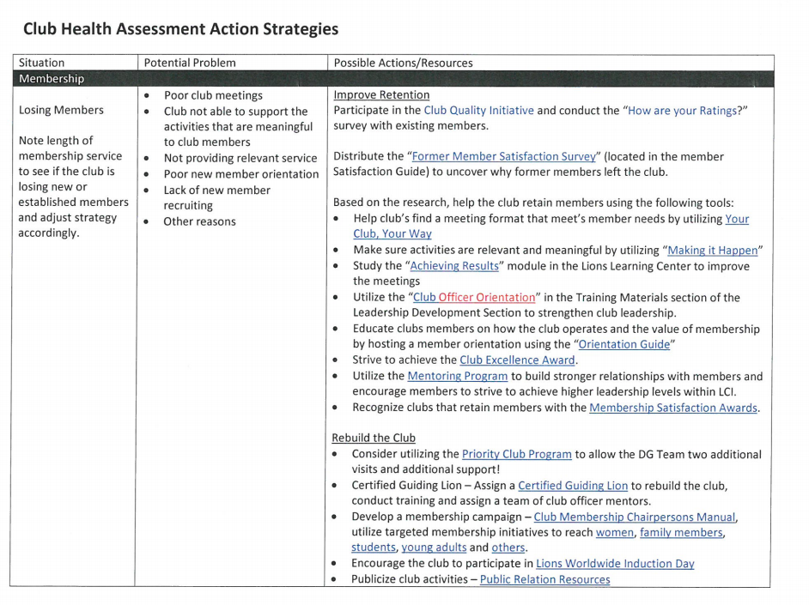
aa
Club Health Assessment Action Strategies
13

Slide 15
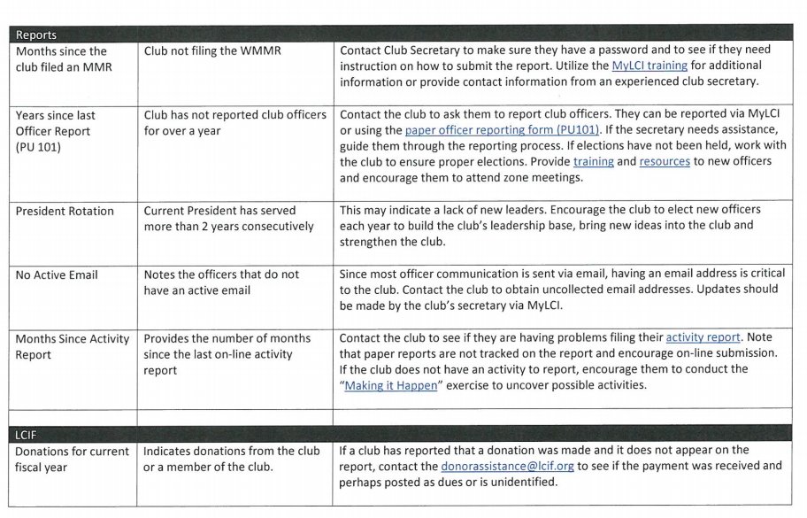
aa
Club Health Assessment Action Strategies
14

Slide 16
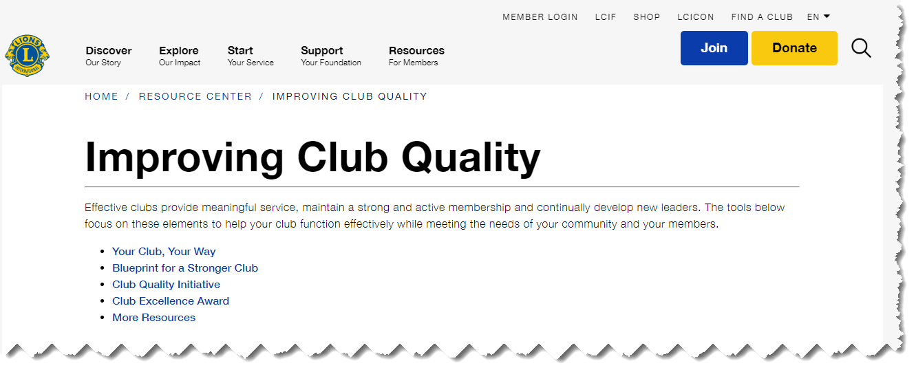
Improving Club Quality Webpage
aa
15

Slide 17




aa
Resources
Your Club, Your Way
Blueprint for a Stronger Club
Club Quality Initiative
Club Excellence Award
16

Slide 18

aa
Your Peers
Your Peers
17

Slide 19
Activity
Using Club Health Resources
Review each club scenario on pages 1-2.
Write down which resources you would use for each scenario.
Be prepared to share your thoughts with the rest of the participants.
Go to pages 5-6 in your participant manual.
You have xxx minutes to complete the exercise
18

Slide 20
Session Objectives
Identify Characteristics of Healthy Clubs
Analyze Club Health Assessment Reports
Use Resources to Boost Club Health
19

